Slide 1

CS 533 INTRO TO DATA SCIENCE
Michael Ekstrand

Slide 2
STATISTICAL GRAPHICS

Slide 3
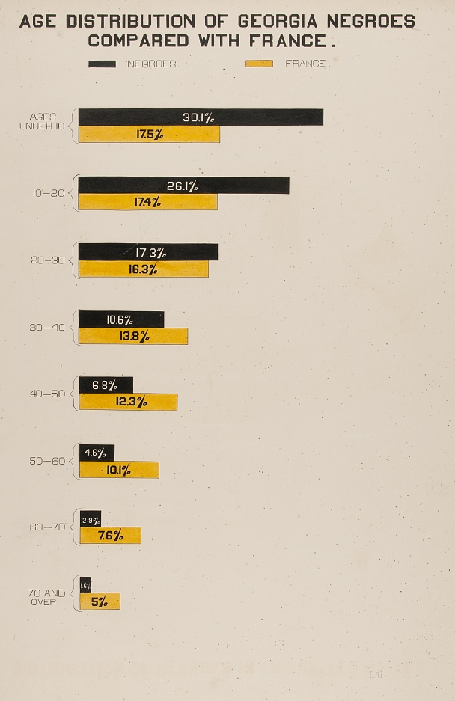
Learning Outcomes
Understand the value of graphics for presenting data
Identify the parts of a statistical image
Understand some pitfalls in graphics
Graphic by W.E.B. Du Bois, for the 1900 World’s Fair in Paris.

Slide 4
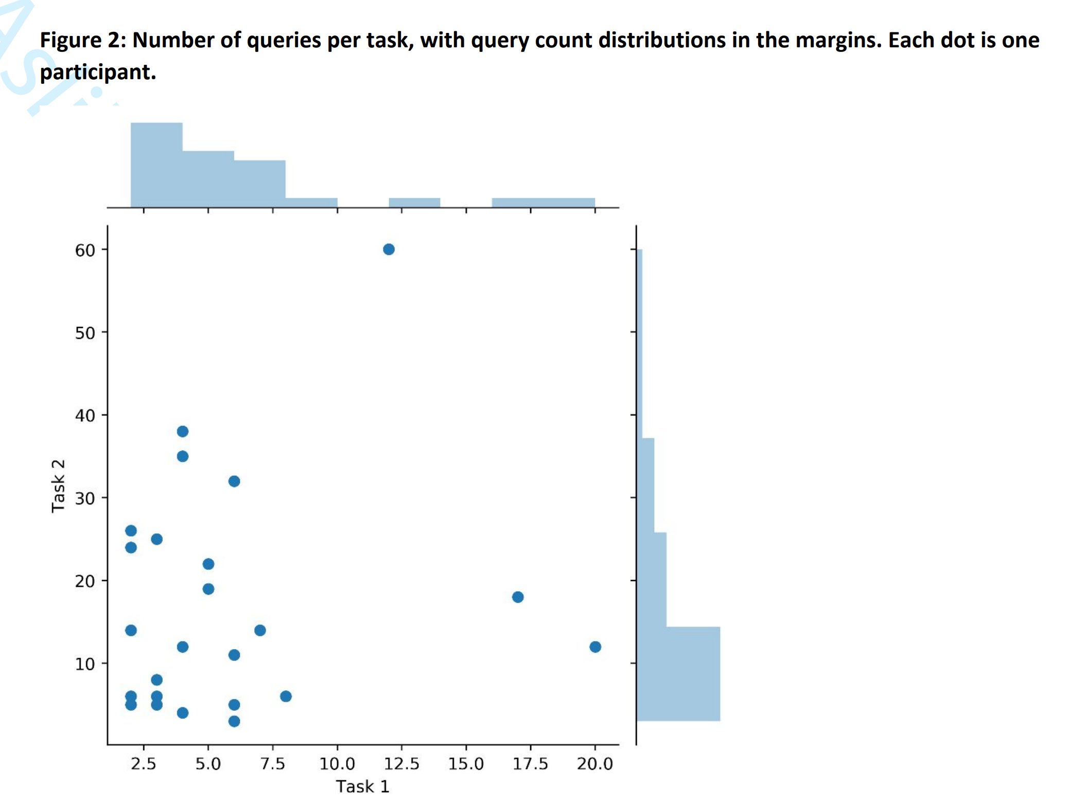
Example Chart
Parts to identify:
X-axis
Y-axis
Axis labels
Data
From “Enhancing Classroom Instruction with Online News”, by Michael D. Ekstrand, Katherine Landau Wright, and Maria Soledad Pera (Aslib Journal of Information Mangement, online June 2020)

Slide 5
What Charts Can Reveal
Patterns (or lack thereof)
Comparisons
Compare two bars
See where points are
Trends
Do lines go up or down? Or jaggedy?

Slide 6
Documenting Charts
Clearly state:
What is being presented (what is each point?)
What values are plotted on the axes
Often, this is done in the axis label
Make sure units are clear if relevant
Sometimes this can be implicit, but if in any doubt: be explicit
The chart + caption should be interpretable on their own!
Observations may be saved for referencing text.

Slide 7
Captions, Titles, and Context
In a paper, a figure has a caption
Labels the figure
Can provide interpretive guidance
Other contexts, we often need a title
Shorter, doesn’t explain details
Labels the whole figure
In notebooks, surrounding text may be sufficient, but title often a good idea for quick reading.

Slide 8
Pitfalls
Distorting perspective or distances – make sure lengths accurately represent quantities
Bar charts start at 0!
Violating conventions
Users have expectations, e.g. linear, even spacing

Slide 9
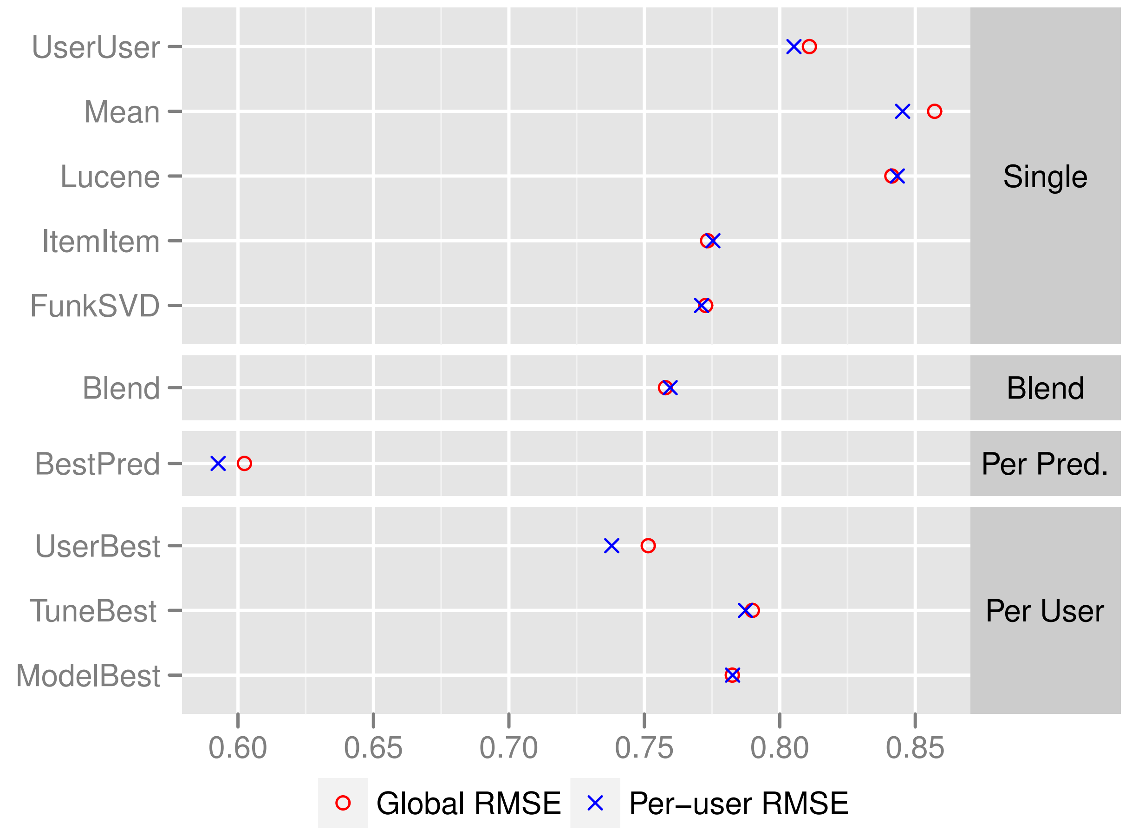
Don’t Rely on Graphics
Graphics illustrate an effect
They may help find an effect
They are not conclusive proof of an effect

Slide 10

Wrapping Up
Graphics can make data clearer, leverage human perception to understand it.
Graphics are not a replacement for numeric analysis, but give it context.
Clearly label and describe graphics.
Photo by Susn Matthiessen on Unsplash

